Slide 1
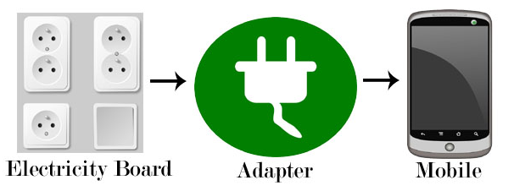
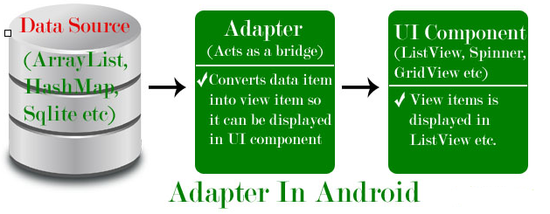
Adapter
Adapter is a bridge between UI component and data source that helps us to fill data in UI component.
It holds the data and send the data to an Adapter view then view can takes the data from the adapter view and shows the data on different views like as ListView, GridView, Spinner etc.
To fill data in a list or a grid we need to implement Adapter.
Here data source is the source from where we get the data and UI components are list or grid items in which we want to display that data.

Slide 2
Adapter
Adapters In Android:
There are the some commonly used Adapter in Android used to fill the data in the UI components:
BaseAdapter – It is parent adapter for all other adapters
ArrayAdapter – It is used whenever we have a list of single items which is backed by an array
Custom ArrayAdapter – It is used whenever we need to display a custom list
SimpleAdapter – It is an easy adapter to map static data to views defined in your XML file
Custom SimpleAdapter – It is used whenever we need to display a customized list and needed to access the child items of the list or grid
Note :
ArrayAdapter is more simple and commonly used Adapter in android.
Whenever you have a list of single type of items like an array, we use ArrayAdapter. Ex. List of phone contacts, countries or names.

Slide 3
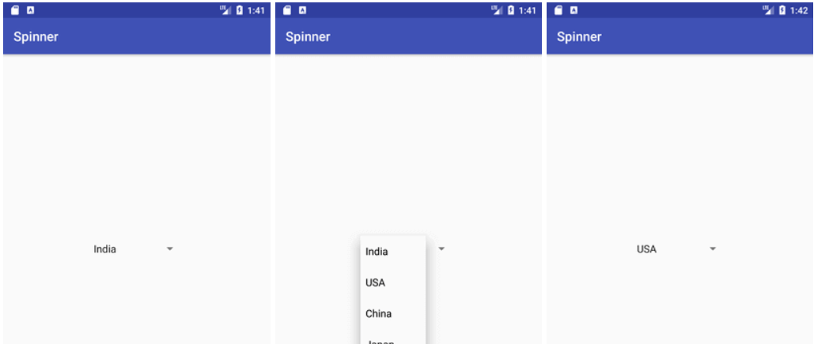
Spinner

Slide 4
Spinner
It can be used to display the multiple options to the user in which only one item can be selected by the user.
Android spinner is like the drop down menu with multiple values from which the end user can select only one value.
Android spinner is associated with AdapterView. So you need to use one of the adapter classes with spinner.

Slide 5
Spinner
Acitivitymain.xml
Drag the spinner from design layout
<Spinner
android:id="@+id/spinner"
android:layout_width="149dp"
android:layout_height="40dp"
android:layout_marginBottom="8dp"
android:layout_marginEnd="8dp"
android:layout_marginStart="8dp"
android:layout_marginTop="8dp"
app:layout_constraintBottom_toBottomOf="parent"
app:layout_constraintEnd_toEndOf="parent"
app:layout_constraintHorizontal_bias="0.502"
app:layout_constraintStart_toStartOf="parent"
app:layout_constraintTop_toTopOf="parent"
app:layout_constraintVertical_bias="0.498" />
</android.support.constraint.ConstraintLayout>

Slide 6
Spinner
package com.sindhu.customtoast;
import androidx.appcompat.app.AppCompatActivity;
import android.os.Bundle;
import android.view.View;
import android.widget.AdapterView;
import android.widget.ArrayAdapter;
import android.widget.Spinner;
import android.widget.Toast;
public class MainActivity extends AppCompatActivity {
String[] country = {"India", "USA", "China", "Japan", "Other"};
@Override
protected void onCreate(Bundle savedInstanceState) {
super.onCreate(savedInstanceState);
setContentView(R.layout.activity_main);

Slide 7
Spinner
Spinner spin = findViewById(R.id.spinner);
//Creating the ArrayAdapter instance having the country list
ArrayAdapter aa = new ArrayAdapter(this, android.R.layout.simple_spinner_item, country);
aa.setDropDownViewResource(android.R.layout.simple_spinner_dropdown_item);
//Setting the ArrayAdapter data on the Spinner
spin.setAdapter(aa);

Slide 8
Spinner
spin.setOnItemSelectedListener(new AdapterView.OnItemSelectedListener() {
@Override
public void onItemSelected(AdapterView<?> adapterView, View view, int i, long l) {
Toast.makeText(getApplicationContext(),country[i] , Toast.LENGTH_LONG).show();
}
@Override
public void onNothingSelected(AdapterView<?> adapterView) {
}
});
}
}

Slide 9
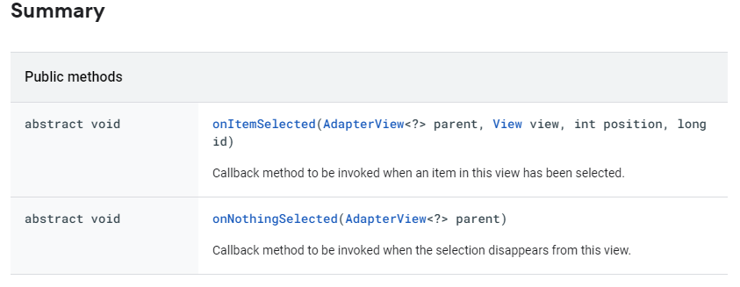
Spinner
public static interface AdapterView.OnItemSelectedListener
Interface definition for a callback to be invoked when an item in this view has been selected.

Slide 10
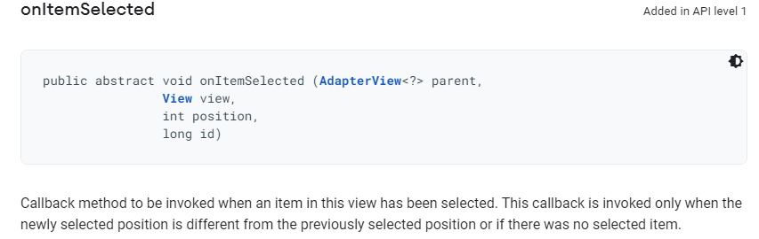
Spinner

Slide 11
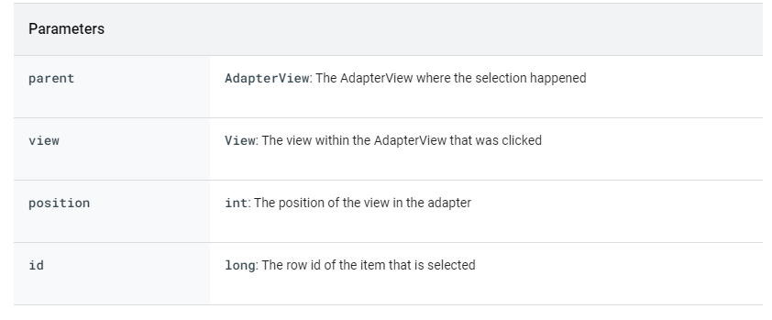
Spinner

Slide 12
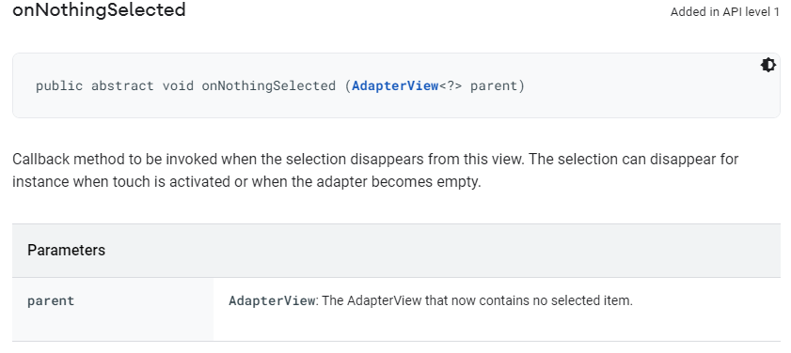
Spinner

Slide 13
Spinner
Create an application to choose the IPL Teams from a dropdown and when a team is selected it should open another activity and display the choosen team name.

